Slide 1
GridWorld Case Study
Barbara Ericson
March 24, 2007

Slide 2
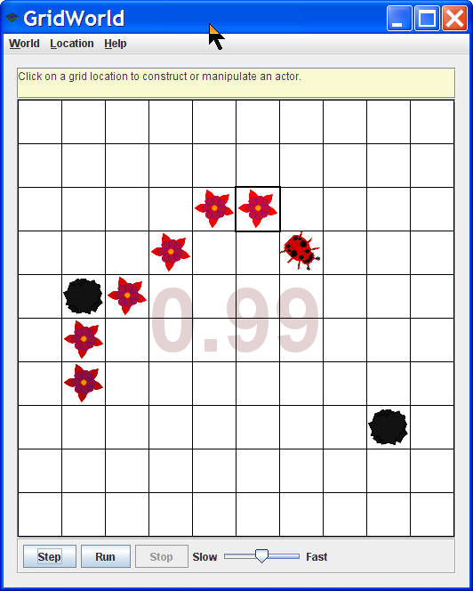
Chapter 1: Intro to GridWorld
Open BugRunner.java
  Run the main method
Click the step button
Click on an empty grid cell and create a rock in front of the bug
  Click on the Step button
Click on a bug
  Get a menu of methods
    Click on a method to invoke it
Click on a flower and a rock too

Slide 3
Exercise Set 1
Does the bug always move to a new location?
In what direction does the bug move?
What does the bug do if it can’t move?
What does the bug leave behind when it moves?
What happens when the bug is at the edge of the grid?
  And facing the edge?
  And not facting the edge?
What happens when a bug is facing a rock and you click step?
Does a flower move?
What behavior does a flower have?
Does a rock move or have any other behavior?
Can more than one actor (bug, flower, rock) be in the same grid location at the same time?

Slide 4
Exercise Answers Set 1
Does the bug always move to a new location?
  No
In what direction does the bug move?
  The direction it is facing
What does the bug do if it can’t move?
  Turns right 45 degrees
What does the bug leave behind when it moves?
  A flower
What happens when the bug is at the edge of the grid?
  And facing the edge?
    Turns 45
  And not facing the edge?
    Continues to move if it can
What happens when a bug is facing a rock and you click step?
  It turns 45 degrees to the right.
Does a flower move?
  No
What behavior does a flower have?
  The color gets darker over time. It can act. It inherits other behavior from Actor (setColor, setDirection, etc)
Does a rock move or have any other behavior?
  It doesn’t change over time. It can act. It inherits other behavior from Actor (setColor, setDirection, etc)
Can more than one actor (bug, flower, rock) be in the same grid location at the same time?
  No

Slide 5
Exercises
Click on a bug, flower, or rock
  Invoke the setDirection method
Fill in the following table for the setDirection method
Degrees | Direction
0 | North
45
90
135
180
225
270
315
360

Slide 6
Exercise Answers
Click on a bug, flower, or rock
  Invoke the setDirection method
Fill in the following table for the setDirection method
Can you set the direction to an angle that isn’t a multiple of 45?
  What happens?
Degrees | Direction
0 | North
45 | Northeast
90 | East
135 | Southeast
180 | South
225 | Southwest
270 | West
315 | Northwest
360 | North

Slide 7
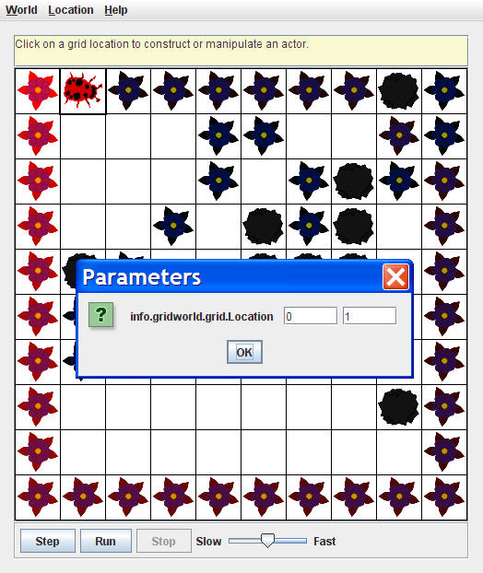
Exercise
Use the moveTo method to move a bug
  Does it change direction?
  How far can you move it?
  What happens if you try to move it outside the grid?
  What is the top left location?
  What is the bottom right location?

Slide 8
Exercise Answers
Use the moveTo method to move a bug
  Does it change direction?
    No
  How far can you move it?
    Anywhere in the grid
  What happens if you try to move it outside the grid?
    You get an IllegalArgumentException
  What is the top left location?
    0,0
  What is the bottom right location?
    9,9

Slide 9
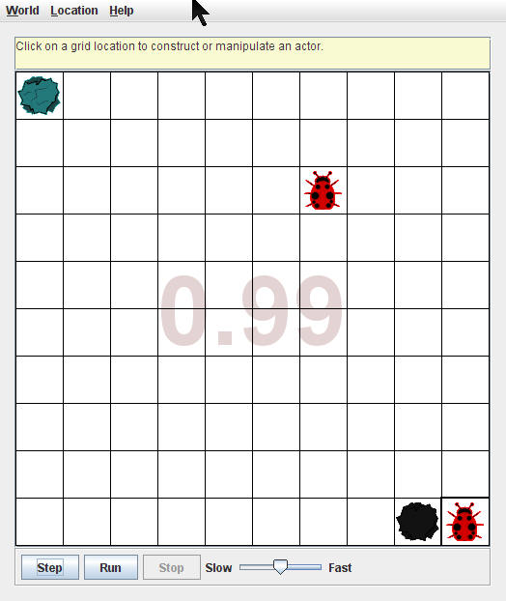
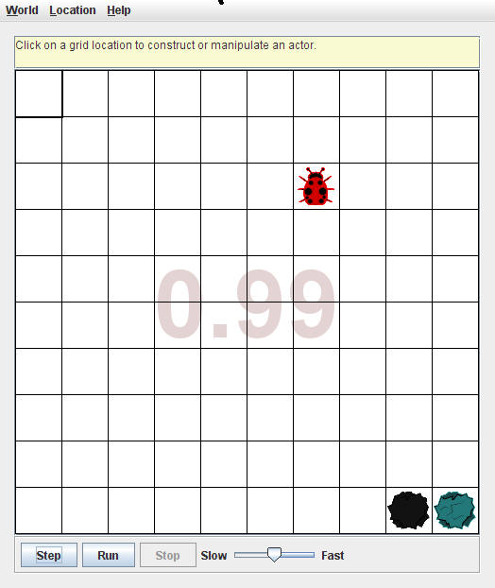
Exercise
What method can you use to change the color of a bug, rock, or flower?
Move a rock to a location with a bug in it. Move the rock again to another location. What happened to the bug?
What methods are defined in bug
  Not just inherited from Actor?

Slide 10
Exercise Answers
What method can you use to change the color of a bug, rock, or flower?
  setColor
Move a rock to a location with a bug in it. Move the rock again to another location. What happened to the bug?
  It is removed from the world
What methods are defined in bug
  Not just inherited from Actor
    act, move, turn, canMove

Slide 11
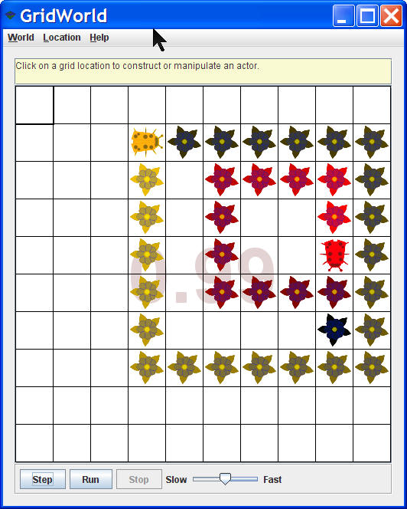
Chapter 2: Bug Variations
Create new kinds of bugs
  Open classes in projects/boxBug
  BoxBug
    Moves in a square pattern
      Instance variables of sideLength and steps
      Overrides the act method

Slide 12
Exercise Set 2
What is the role of the instance variable sideLength?
What is the role of the instance variable steps?
Why is the turn method called twice when steps becomes equal to sideLength?
Why can the move method be called in BoxBug when there is no move method in the BoxBug class?
After a BoxBug is constructed will the size of the square pattern always be the same?
Can the path a BoxBug travels ever change?
When will the value of steps be zero?

Slide 13
Exercise Answers Set 2
What is the role of the instance variable sideLength?
  The number of grid cells in one side of the box – 1.
What is the role of the instance variable steps?
  Keeps track of the current number of steps the bug has taken on the current side.
Why is the turn method called twice when steps becomes equal to sideLength?
  To make a 90 degree turn (each turn is 45 degrees)
Why can the move method be called in BoxBug when there is no move method in the BoxBug class?
  It is inherited from Bug since the BugBog class extends the Bug class
After a BoxBug is constructed will the size of the square pattern always be the same?
  Yes, there is no mutator (modifier) method in BoxBug for sideLength
Can the path a BoxBug travels ever change?
  Yes, if it can’t move it turns 90 degrees.
When will the value of steps be zero?
  When it is constructed and after each 90 degree turn.

Slide 14
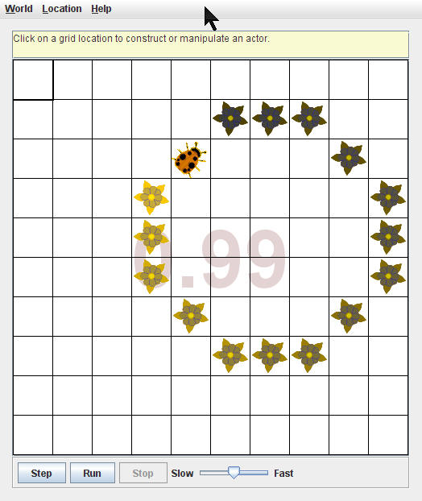
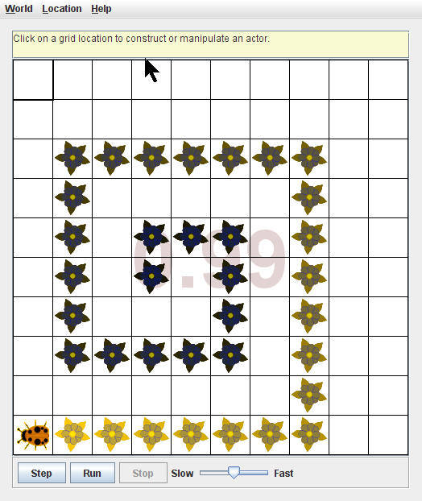
New Bug Classes
CircleBug
  Like BoxBug but only one turn
    45 degree turn
SpiralBug
  Like BoxBug but the sideLength gets longer after each turn
    90 degree turn

Slide 15
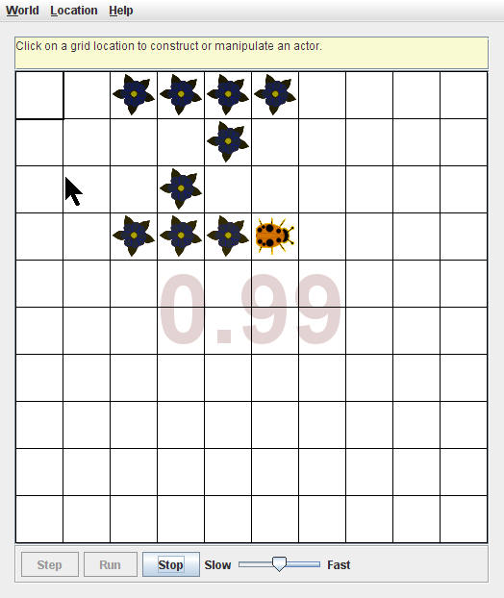
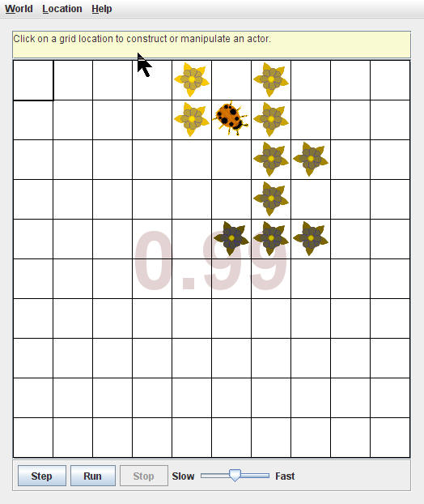
New Bug Classes
ZBug
  Draws a Z and then stops moving
DancingBug
  Takes an array of integers which are the number of turns it makes when asked to act
  Then it acts like a Bug

Slide 16
Problem
The GridWorld case study says to make CircleBug and SpiralBug like BoxBug
  Hints at copy and paste
    Should use inheritance
  But sideLength and steps are private in BoxBug
  Can add public accessors and modifier methods to BoxBug
    And inherit from BoxBug
      But is a CircleBug a kind of BoxBug?
  Better to pull out sideLength and steps and put in a PatternBug abstract class
    And have BoxBug inherit from PatternBug

Slide 17
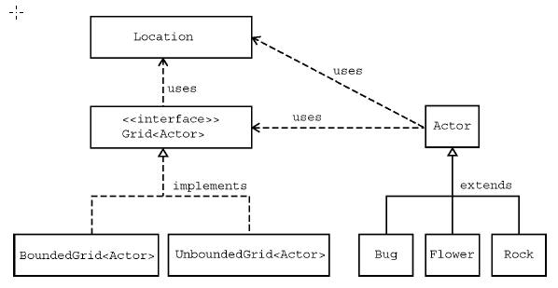
Chapter 3: Classes and Interfaces
Main classes are:
  Location – Class
  Grid of Actors - Interface
    BoundedGrid of Actors - Class
    UnboundedGrid of Actors - Class
  Actor – Class
    Bug – Class
    Flower – Class
    Rock - Class

Slide 18
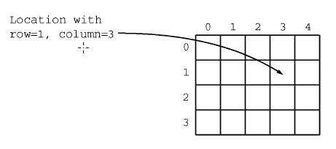
Location Class
Encapsulates a grid location
  Row and Column number
    Rows increase going down
    Columns increase going right
  Also has methods that determine relationships between locations and compas directions
    Including constants for NORTH, NORTHEAST, LEFT, RIGHT, etc

Slide 19
Location Class
Accessor methods
  getRow
  getCol
Working with locations
  Get a neighbor location in a direction
    public Location getAdjacentLocation(int direction)
  Get the closest compass direction toward target
    public int getDirectionToward(Location target)
Two Location objects are equal if they have the same row and column
  Location also implements the Comparable interface

Slide 20
Turning by an Amount
We have been using multiple calls to the turn method to turn an Actor
  We can use setDirection and Location constants for this instead
  setDirection(getDirection + Location.HALF_RIGHT); // turn 45 degrees

Slide 21
Exercise Set 3
Given
  Location loc1 = new Location(4,3);
  Locaiton loc2 = new Location(3,4);
How would you access the row value of loc1?
What is the value of b after the following statement is executed?
  boolean b = loc1.equals(loc2);
What is the value of loc3 after the following?
  Location loc3 = loc2.getAdjacentLocation(Location.SOUTH);
What is the value of dir after the following?
  Int dir = loc1.getDirectionToward(new Location(6,5));
How does the getAdjacentLocation method know which location to return?

Slide 22
Exercise Answers Set 3
Given
  Location loc1 = new Location(4,3);
  Location loc2 = new Location(3,4);
How would you access the row value of loc1?
  loc1.getRow();
What is the value of b after the following statement is executed?
  boolean b = loc1.equals(loc2); b is false
What is the value of loc3 after the following?
  Location loc3 = loc2.getAdjacentLocation(Location.SOUTH);
  Location(4,4);
What is the value of dir after the following?
  int dir = loc1.getDirectionToward(new Location(6,5)); 135
How does the getAdjacentLocation method know which location to return?
  It uses the passed direction

Slide 23
Grid Interface
Check if a location is valid (is in the grid)
  boolean isValid(Location loc)
Put an object into the location in the grid and return the object that was at this location or null
  E put(Location loc, E obj)
Remove the object at this location in the grid and return it or null
  E remove(Location loc)
Return the object at this location in the grid or null
  E get(Location loc)
Get an array list of locations that are occupied
  ArrayList<Location> getOccupiedLocations()
Get the number of rows or columns (-1 for unbounded)
  int getNumRows(), int getNumCols()

Slide 24
Getting Neighbors in a Grid
Return all valid locations adjacent to a given location
  ArrayList<Location> getValidAdjacentLocations(Location loc)
Return all valid empty locations adjacent to a given location
  ArrayList<Location> getEmptyAdjacentLocations(Location loc)
Return all valid occupied locations adjacent to a given location
  ArrayList<Location> getOccupiedAdjacentLocations(Location loc)
Returns all the objects in the occupied adjacent locations
  ArrayList<E> getNeighbors(Location loc)

Slide 25
Exercise Set 4
How can you get a count of the objects in the grid?
How can you get a count of the empty locations in the grid?
How can you check if location(10,10) is in the grid?
Grid contains method declarations but no code. Why?
Where can you find the code for the methods?
All methods that can return multiple objects return them in an ArrayList. Would it have been a better design to return them in an array? Explain your answer.

Slide 26
Exercise Answers Set 4
How can you get a count of the objects in the grid?
  getOccupiedLocations().size()
How can you get a count of the empty locations in the grid?
  getNumRows() * getNumCols() – getOccupiedLocations.size()
How can you check if location(10,10) is in the grid?
  isValid(new Location(10,10));
Grid contains method declarations but no code. Why?
  It is an interface
Where can you find the code for the methods?
  In the classes that implement the interface: BoundedGrid and UnboundedGrid
All methods that can return multiple objects return them in an ArrayList. Would it have been a better design to return them in an array? Explain your answer.
  ArrayLists are arrays that can grow or shrink. They are better than arrays when you don’t know how many items you will have.

Slide 27
Actor Class
public Color getColor()
public int getDirection()
public Grid<Actor> getGrid()
public Location getLocation()
public void putSelfInGrid(Grid<Actor> gr, Location loc)
  Use this for adding an actor to the grid as it also set the Actor’s location
public void removeSelfFromGrid();
  Use this for removing an Actor from the grid. It sets the grid and location instance variables to null.

Slide 28
Actor Class
Moves this Actor to the given location and removes anything currently at this location
  public void moveTo(Location loc)
Mutator (modifier) methods
  public void setColor(Color newColor)
  public void setDirection(int newDir)
Act method: by default reverses direction. Override this method in subclasses.
  public void act()

Slide 29
Exercise Set 5
Name 3 properties that every Actor has.
When an actor is constructed what is its direction and color?
Why was the Actor class created as a class and not an interface?
Can an Actor put itself in the grid twice without removing itself?
Can an Actor remove itself from the grid twice?
Can an actor place itself in the grid and then remove itself and then add itself to the grid? Try it. What happens?
How can an actor turn 90 degrees to the right?

Slide 30
Exercise Answers Set 5
Name 3 properties that every Actor has.
  Color, direction, location
When an actor is constructed what is its direction and color?
  Blue and North
Why was the Actor class created as a class and not an interface?
  Use classes or abstract classes when we want to provide fields and methods. Interfaces can only define constants and abstract methods.
Can an Actor put itself in the grid twice without removing itself?
  No, you will get an IllegalStateException
Can an Actor remove itself from the grid twice?
  No, you will get an IllegalStateException
Can an actor place itself in the grid and then remove itself and then add itself to the grid? Try it. What happens?
  Should work.
How can an actor turn 90 degrees to the right?
  setDirection(getDirection() + Location.RIGHT);

Slide 31
Rock and Flower Classes
Subclasses of Actor
  Override act()
Rocks don’t do anything in the act method
  Empty body {}
Flowers change the color
  reduces the red, green, and blue by the same amount (0.05)

Slide 32
Bug Class
Extends Actor
In act() check if can move and if can move, move, and drop a flower in the old location, else turn (45 degrees)
    public void act()
    {
    if (canMove())
    move();
    else
    turn();
    }

Slide 33
canMove Method
A bug can move if
  It is in a grid
  And the location in front of it is a valid location
  And there is either nothing in this location or there is a flower in this location
    Uses neighbor instanceof Flower to check this
    public boolean canMove()
    {
    Grid<Actor> gr = getGrid();
    if (gr == null)
    return false;
    Location loc = getLocation();
    Location next = loc.getAdjacentLocation(getDirection());
    if (!gr.isValid(next))
    return false;
    Actor neighbor = gr.get(next);
    return (neighbor == null) || (neighbor instanceof Flower);
    // ok to move into empty location or onto flower
    // not ok to move onto any other actor
    }

Slide 34
Exercise Set 6
Which statement in the canMove method ensures that a bug doesn’t move out of the grid?
Which statement in the canMove method keeps a bug from walking into a rock?
Which methods from the Grid interface are invoked in the canMove method and why?
Which method in the Location class is invoked in the canMove method and why?
Which methods inherited from the Actor class are invoked in the canMove method and why?
What happens in the move method when the location in front of the bug is out of the grid?
Is the variable loc needed in the move method or could it be avoided by calling getLocation() multiple times?
Why do you think that the flowers that are dropped by the bug have the same color as the bug?
When a bug removes itself from the grid will it, will it place a flower in its previous location?
Which statement in the move method places a flower in the grid at the previous location?
If a bug needs to turn 180 degrees how many times should it call the turn method?

Slide 35
Exercise Answers Set 6
Which statement in the canMove method ensures that a bug doesn’t move out of the grid?
  if (!gr.isValid(next))
Which statement in the canMove method keeps a bug from walking into a rock?
  return (neighbor == null) || (neighbor instanceof Flower);
Which methods from the Grid interface are invoked in the canMove method and why?
  isValid is used to check if the location in front of the bug is value and get is used to get the object in the grid in front of the bug
Which method in the Location class is invoked in the canMove method and why?
  getAdjacentLocation to get the location in front of the bug
Which methods inherited from the Actor class are invoked in the canMove method and why?
  getGrid is used to check that the bug is in a grid, and getLocation is used to get the current location

Slide 36
Exercise Answers Set 6
What happens in the move method when the location in front of the bug is out of the grid?
  The bug removes itself from the grid
Is the variable loc needed in the move method or could it be avoided by calling getLocation() multiple times?
  It is needed to store the previous location so that a flower can be put there
Why do you think that the flowers that are dropped by the bug have the same color as the bug?
  To make it clear which bug they come from
When a bug removes itself from the grid will it, will it place a flower in its previous location?
  Yes
Which statement in the move method places a flower in the grid at the previous location?
  flower.putSelfInGrid(gr, loc);
If a bug needs to turn 180 degrees how many times should it call the turn method?
  180 / 45 = 4

Slide 37
Jumper Activity
In groups of 3-5 students
  Create a Jumper class.
    Objects of this class can move forward 2 cells and can jump over rocks or flowers. They don’t leave anything behind
  Discuss the following:
    What happens if the next location is empty but the one two in front contains a rock or flower?
    What should happen if the location two in front is out of the grid?
    What should a Jumper do if it is facing the edge of the grid?
    What should a Jumper do if the location two in front has another Actor in it (not a Flower or Rock)
    What will a Jumper do if it encounters another Jumper?
    Are there any other tests a Jumper needs to make?

Slide 38
Jumper Activity Cont.
Consider the following design issues:
  Which class should Jumper extend?
  Is there an existing class that is similar to Jumper?
  Should you create a constructor? What parameters should it have?
  Which methods should be overriden?
  What new methods should be added?
  How will you test the class?
Code the Jumper and JumperRunner classes
Test the Jumper class
  Or give it to another group to test

Slide 39
The Graphical User Interface
The World class connects the described classes and the GUI
  The GUI asks the World for the grid, gets the objects in the grid, and draws them at their locations
  ActorWorld is a subclass of World
    That has a step method that calls act() on each object in the Grid
    Has methods for adding objects
      public void add(Location loc, Actor theActor)
      public void add(Actor theActor)
        Adds the actor to a random location
    Has a method for removing objects
      Public Actor remove(Location loc)

Slide 40
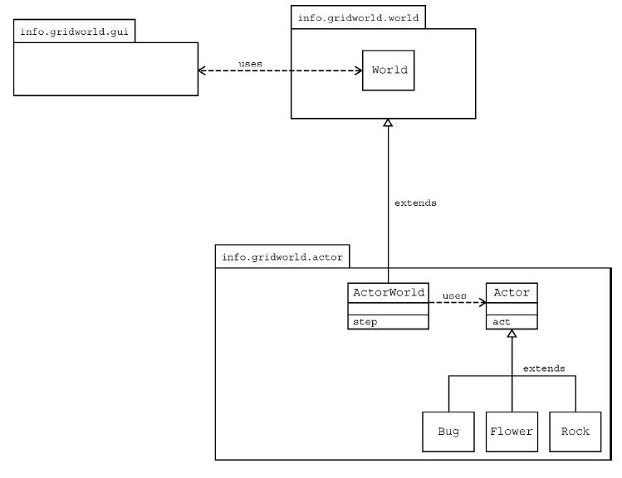
Class Diagram
Notes:
This is a UML class diagram that shows classes in the packages they are in as well as the relationships between the classes.

Slide 41
Part 4: Interacting Objects
Critters are actors that have a common pattern for behavior
  Use the same act() method
When a critter acts it:
  gets a list of actors to process
    ArrayList<Actor> getActors()
  processes the actors
    void processActors(ArrayList<Actor> actors);
  generates a list of locations it can move to
    ArrayList<Location> getMoveLocations()
  selects a location
    Location selectMoveLocation(ArrayList<Location> locList)
  moves to the selected location
    void makeMove(Location loc)

Slide 42
Exercise Set 7
What methods are implemented in Critter? What does each do?
What are the 5 basic actions common to all Critters when they act?
Should subclasses of Critter override the getActors() method?
Describe 3 ways a Critter could process actors?
What 3 methods must be invoked to make a Critter move? Explain each method.
Why is there no Critter constructor?

Slide 43
Exercise Answers Set 7
What methods are implemented in Critter? What does each do?
  act, getActors, processActors, getMoveLocations, selectMoveLocation, makeMove
    Act checks that the Critter is in a grid and if so calls the other methods
    getActors gets the neighboring Actors
    processActors eats (removes) actors that are not Rocks or Critters
    getMoveLocations returns valid empty neighboring locations (1 cell away)
    selectMoveLocation returns current location if no empty neighbors or a random empty neighbor
    makeMove if the location is null remove self from grid otherwise move to the location
What are the 5 basic actions common to all Critters when they act?
  Get actors to process, process the actors, get a list of locations, select a location, move
Should subclasses of Critter override the getActors() method?
  Yes, if they want to control the type of actors to interact with or to get more than just the neighboring Actors (one cell away)
Describe 3 ways a Critter could process actors?
  Change their color, Change their direction, remove them from the grid, etc
What 3 methods must be invoked to make a Critter move?
  getMoveLocations, selectMoveLocation, makeMove.
Why is there no Critter constructor?
  Because it inherits from Actor and Actor has a no-arg constructor so by not providing any constructors the compiler will add a no-arg constructor that calls super()

Slide 44
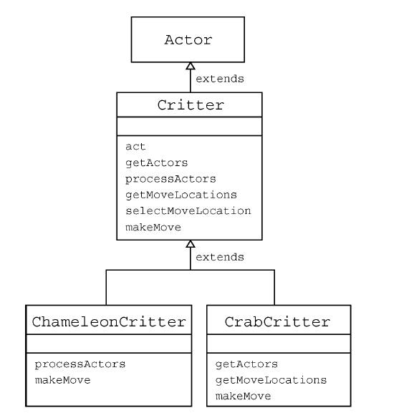
Extending the Critter Class
ChameleonCritter
  Overrides processActors to pick a random actor and change its current color to the actor’s color
  Overrides makeMove to also turn toward the new location
CrabCritter
  Overrides getActors to get actors straight ahead, diagonal left, and diagonal right (from front)
  Overrides getMoveLocations to only move to the left or right
  Overrides makeMove so that if it doesn’t move it randomly turns left or right

Slide 45
Exercise Set 8
Why does act cause a ChameleonCritter to act differently than a Critter even though act is not overriden?
Why does the makeMove method of ChameleonCritter call super.makeMove?
How would you make a ChameleonCritter drop a flower in the old location when it moves?
Why doesn’t ChameleonCritter override the getActors method?
Which class contains the getLocation method?
How can a Critter access its own grid?

Slide 46
Exercise Answers Set 8
Why does act cause a ChameleonCritter to act differently than a Critter even though act is not overriden?
  Because some of the methods act calls are overriden
Why does the makeMove method of ChameleonCritter call super.makeMove?
  Because it wants to do the same actions as the parent class
How would you make a ChameleonCritter drop a flower in the old location when it moves?
  Save the current location before you move and then create a flower and add it to this saved location just like in Bug
Why doesn’t ChameleonCritter override the getActors method?
  It wants the same behavior
Which class contains the getLocation method?
  Actor
How can a Critter access its own grid?
  The inherited getGrid method (from Actor)

Slide 47
Exercise Set 9
Why doesn’t CrabCritter override the processActors method?
Describe the process CrabCritter uses to find and eat actors.
  Does it always eat all neighboring actors?
  Explain.
Why is the getLocationsInDirections method used in CrabCritter?
If a CrabCritter has location (3,4) and faces south what are the possible locations for actors returned by getActors?
What are the similarities and differences between the movements of a CrabCritter and a Critter?
How does a CrabCritter determine when it turns instead of moving?
Why don’t the CrabCitters objects eat each other?

Slide 48
Exercise Answers Set 9
Why doesn’t CrabCritter override the processActors method?
  Because it wants to eat the actors which is what the method in Critter does
Describe the process CrabCritter uses to find and eat actors.
  Does it always eat all neighboring actors?
    No only the ones in front, or diagonally left or right
  Explain.
    It overrides getActor to get only these and then calls processActors to eat them
Why is the getLocationsInDirections method used in CrabCritter?
  To get the locations in front, diagonally left and right to get Actors in these locations
If a CrabCritter has location (3,4) and faces south what are the possible locations for actors returned by getActors?
  (4,4), (4, 3), (4,5)

Slide 49
Exercise Answers Set 9
What are the similarities and differences between the movements of a CrabCritter and a Critter?
  If a CrabCritter can’t move it randomly turns left or right, if it can move it moves like a Critter
How does a CrabCritter determine when it turns instead of moving?
  It turns only if it can’t move
Why don’t the CrabCitters objects eat each other?
  Because processActors in Critter won’t eat other Critters and a CrabCritter is a type of Critter

Slide 50
Chapter 5: Grid Data Structures
AbstractGrid defines methods that are common to BoundedGrid and UnboundedGrid
  public ArrayList<E> getNeighbors(Location loc)
  public ArrayList<E> getValidAdjacentLocations(Location loc)
  public ArrayList<E> getEmptyAdjacentLocations(Location loc)
  public ArrayList<E> getOccupiedAdjacentLocations(Location loc)
  public String toString()
This class must be abstract as it implements Grid but doesn’t define all the methods specified in the Grid interface
  These are defined in BoundedGrid and UnboundedGrid

Slide 51
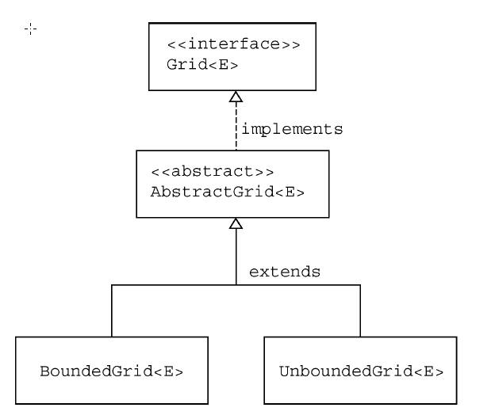
Grid Class Diagram

Slide 52
Exercise Set 10
Where is the isValid method specified?
  Which classes implement this method?
Which AbstractGrid methods call the isValid method? Why don’t other methods call it?
Which methods of the Grid interface are called by the getNeighbors method?
  Which classes implement these methods?
Why must the get method which returns objects of type E be used in the getEmptyAdjacentLocations method when this method returns Location objects?
What would be the affect of replacing the constant Location.HALF_RIGHT with Location.RIGHT where it appears in getValidAdjacentLocatins?

Slide 53
Exercise Answers Set 10
Where is the isValid method specified?
  In concrete subclasses of AbstractGrid
  Which classes implement this method?
    BoundedGrid and UnboundedGrid
Which AbstractGrid methods call the isValid method? Why don’t other methods call it?
  getValidAdjacentLocations others don’t because they call this method
Which methods of the Grid interface are called by the getNeighbors method?
  getOccupiedAdjacentLocations
  Which classes implement these methods?
    AbstractGrid
Why must the get method which returns objects of type E be used in the getEmptyAdjacentLocations method when this method returns Location objects?
  Because that is how it checks that the location is empty
What would be the affect of replacing the constant Location.HALF_RIGHT with Location.RIGHT where it appears in getValidAdjacentLocatins?
  It wouldn’t get diagonal neighbors

Slide 54
BoundedGrid Class
Fixed number of rows and columns
  Throws runtime exception if you try to access a location outside the grid
Stores objects in a two-dimensional array
  private Object[][] occupantArray;
    Can’t declare an array of a generic type in Java

Slide 55
Exercise Set 11
What ensures that a grid has at least one valid location?
How is the number of columns in the grid determined? What assumption makes this possible?
What are the requirements for a Location to be valid in a BoundedGrid?
What type is returned by the getOccupiedLocations method? What is the time complexity (Big-Oh) for this method?
What type is returned by the get method? What is the time complexity (Big-Oh) for this method?
What conditions cause an exception to be thrown by the put method? What is the Big-Oh?
What type is returned by the remove method? What happens if you try to remove from an empty location? What is the Big-Oh?
Based on your answers to 4-7 is this an efficient implementation?

Slide 56
Exercise Answers Set 11
What ensures that a grid has at least one valid location?
  The constructor checks that the number of rows and columns is at least 1
How is the number of columns in the grid determined? What assumption makes this possible?
  return occupantArray[0].length; That there is at least one row and that this is an array of arrays with the inner array being the columns.
What are the requirements for a Location to be valid in a BoundedGrid?
  The row index is >= 0 and < num rows, the col index is >= 0 and less than the number of columns
What type is returned by the getOccupiedLocations method? What is the time complexity (Big-Oh) for this method?
  ArrayList<Location> O(r * c) where r is the number of rows and c is the number of cols
What type is returned by the get method? What is the time complexity (Big-Oh) for this method?
  E O(1)
What conditions cause an exception to be thrown by the put method? What is the Big-Oh?
  If the location isn’t valid or the object is null O(1)
What type is returned by the remove method? What happens if you try to remove from an empty location? What is the Big-Oh?
  E, nothing it just returns null, O(1)
Based on your answers to 4-7 is this an efficient implementation?
  It is pretty efficient for arrays that aren’t too big. If the array is really big and doesn’t include many objects then there are better ways to do the getOccupiedLocations

Slide 57
UnboundedGrid
All locations are valid even if the row and col are negative
Stores objects in a Map<Location,E>
getNumRows() and getNumCols()
  return -1

Slide 58
Exercise Set 12
Which method must the Location class implement so that Location can be used as the key to the map? What would be required if the Map was a TreeMap? Does Location satisfy these requirements?
Why are the checks for null included in the get, put, and remove methods? Why don’t the methods in BoundedGrid do this?
What is the average time complexity (Big-Oh) for get, put, and remove? What would it be if TreeMap where used instead of HashMap?
How would the behavior of the class differ, aside from time complexity if TreeMap where used instead of HashMap?
Could you use a Map for a BoundedGrid? Is there an advantage to using a 2-D array for a BoundedGrid?

Slide 59
Exercise Answers Set 12
Which method must the Location class implement so that Location can be used as the key to the map? What would be required if the Map was a TreeMap? Does Location satisfy these requirements?
  hashCode, implement Comparable consistent with equals, Yes
Why are the checks for null included in the get, put, and remove methods? Why don’t the methods in BoundedGrid do this?
  You can only have one null key in a HashMap
What is the average time complexity (Big-Oh) for get, put, and remove? O(1) What would it be if TreeMap where used instead of HashMap?
How would the behavior of the class differ, aside from time complexity if TreeMap where used instead of HashMap?
  The keys would be kept in sorted order in a TreeMap.
Could you use a Map for a BoundedGrid? Is there an advantage to using a 2-D array for a BoundedGrid?
  Yes, but it would take more space for a small bounded grid and be less efficient when the grid was fairly full.

